Slide 1
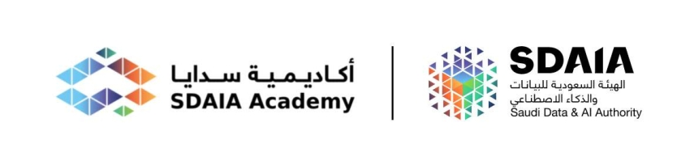

IT Services Interactive Callbot
Name | NO.
Nawaf Almutairi | 1
Surayyi Alqahtani | 2
Shoug Alkhathran | 3
Ahmad Alharthi | 4
Faisal Alsufyani | 5
Instructors: Cooperation with:
Dr. Mejdal Alqahtani Eng. Abdulbari Alghamdi

Slide 2
Content
01 Introduction
02 System Architecture
03 Tools
04 Road map
05 Demo
06 Conclusion

Slide 3
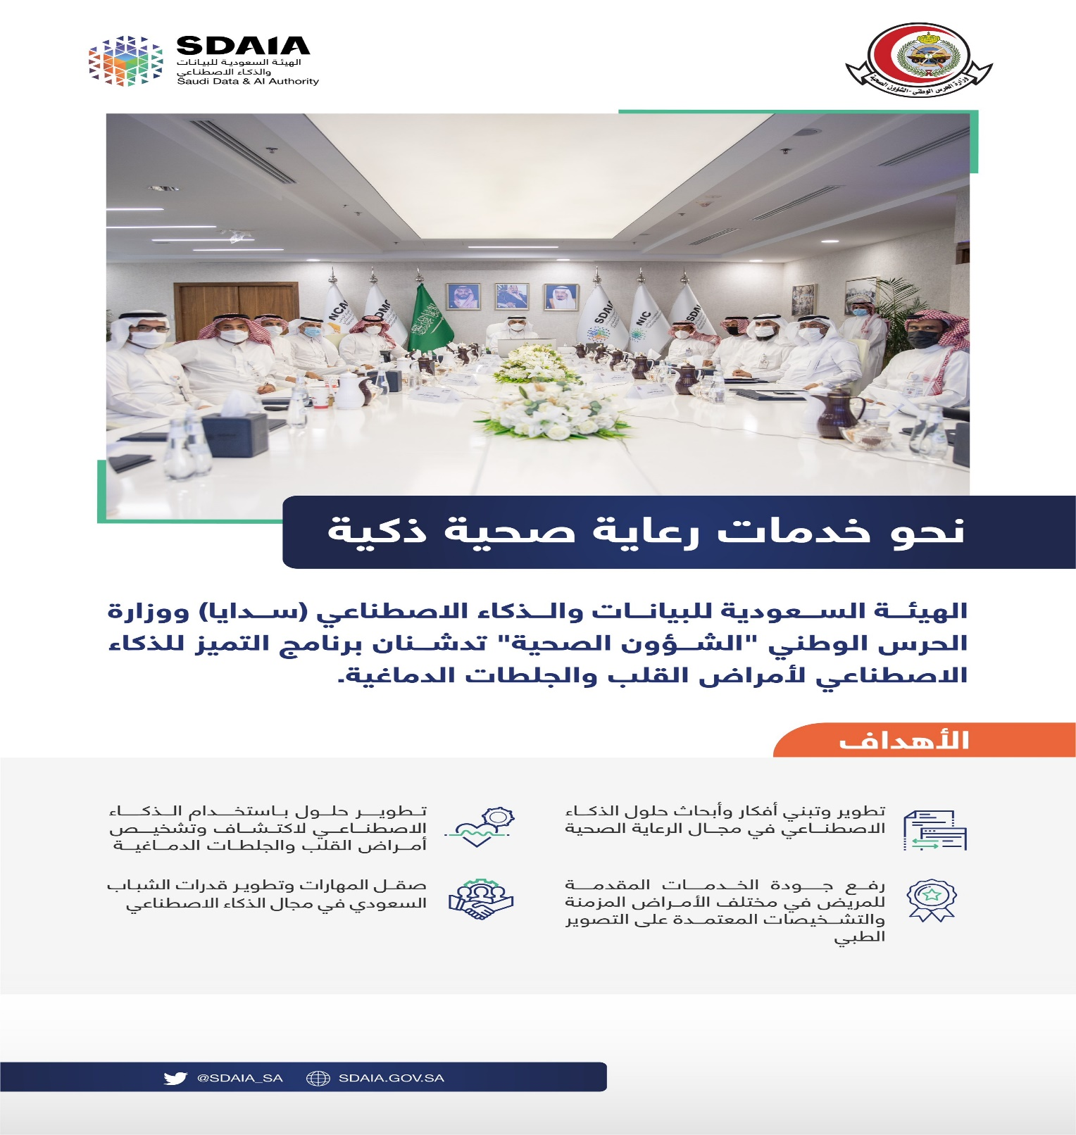
1

Slide 4

INTRODUCTION
Help-Desk System
Is a system used by IT department to log requested services by the organization employees.
Problem Statement
There is high load on the help-desk system which is take time to handle the issues(Software , Hardware..) and maybe not following the requirement details.

Slide 5
System Architecture
Goal
Data Acquisition
Pre-Processing
Modeling

Slide 6

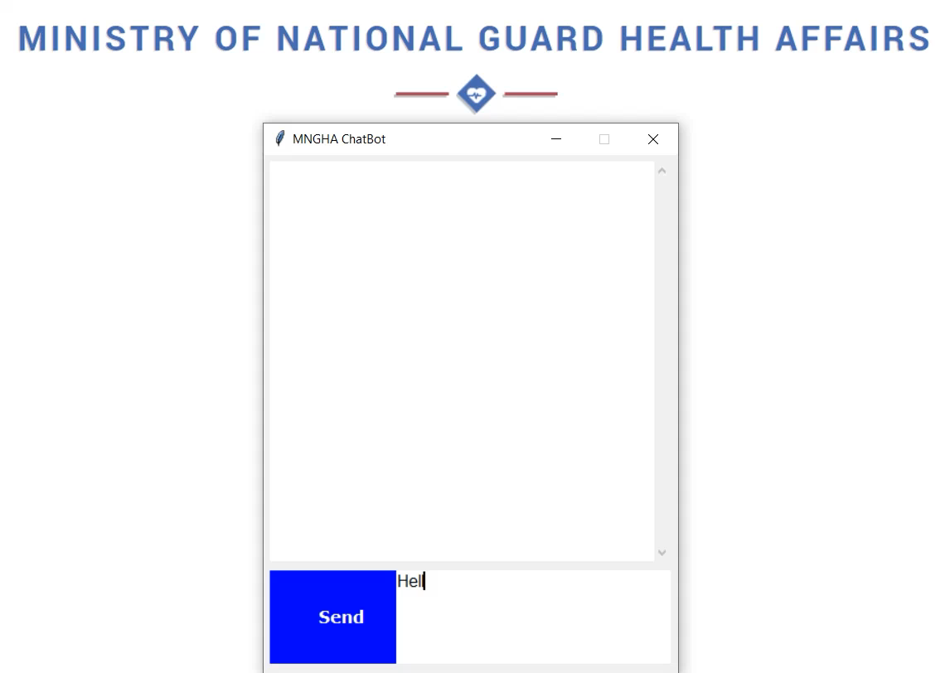
Goal
Chatbot
1
Create a chatbot for Help-Desk system in Ministry of National Guard - Health Affairs
Interact with the employees who requires IT services by text chatting
Integrating with the Help-Desk system
Callbot
Receiving employees voice requests over phone
AI will response to the call by voice
Integrating with the Help-Desk system
2

Slide 7



Data Acquisition
Requester details
Service category
Asset
Entity
 | Badge Number
 | Requester Name
 | Contact Info
 | Email Address
 | Main Category
 | Sub Category
 | Service Type
 | Item
 | Asset Name
 | Asset Building
 | Asset Floor
 | Asset Room
 | Words Tags
 | Patterns
 | Response
3760

Slide 8
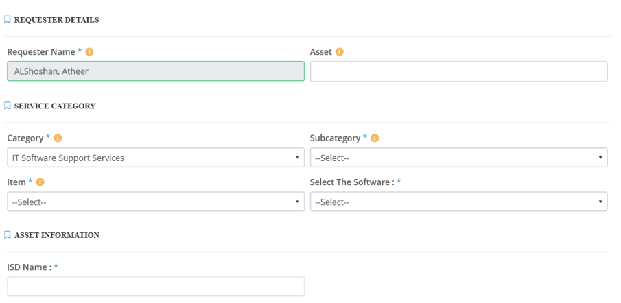
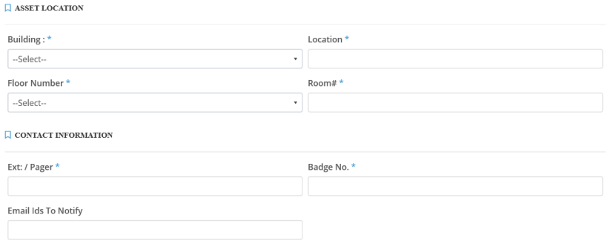
Data Acquisition
An example of a templet from the Help-Desk system

Slide 9





Pre-Processing
Tokenization
chucking (NER)
Remove stopping word and punctuations
Natural Language Processing
Part of speech
Word2vector
Count vectorizer
Term Frequency — Inverse Document Frequency(TF-IDF)

Slide 10
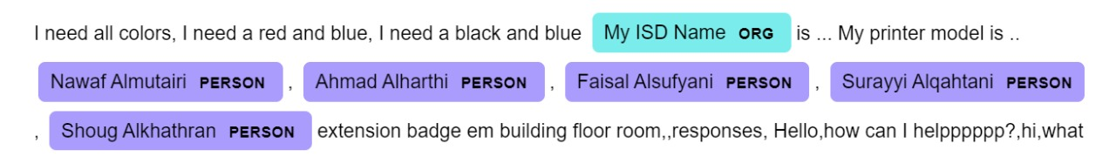
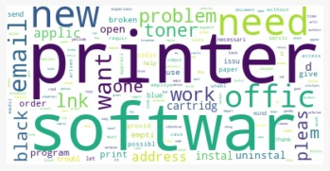
Pre-Processing
An example of Named Entity Recognition:
An example of Word-Cloud
Which is show the
Most Frequent words

Slide 11
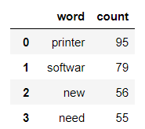
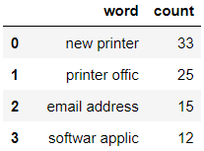
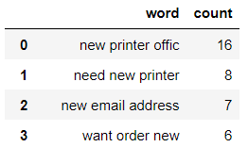
N – Gram Model
Uni-Gram
Bi-Gram
Tri-Gram

Slide 12
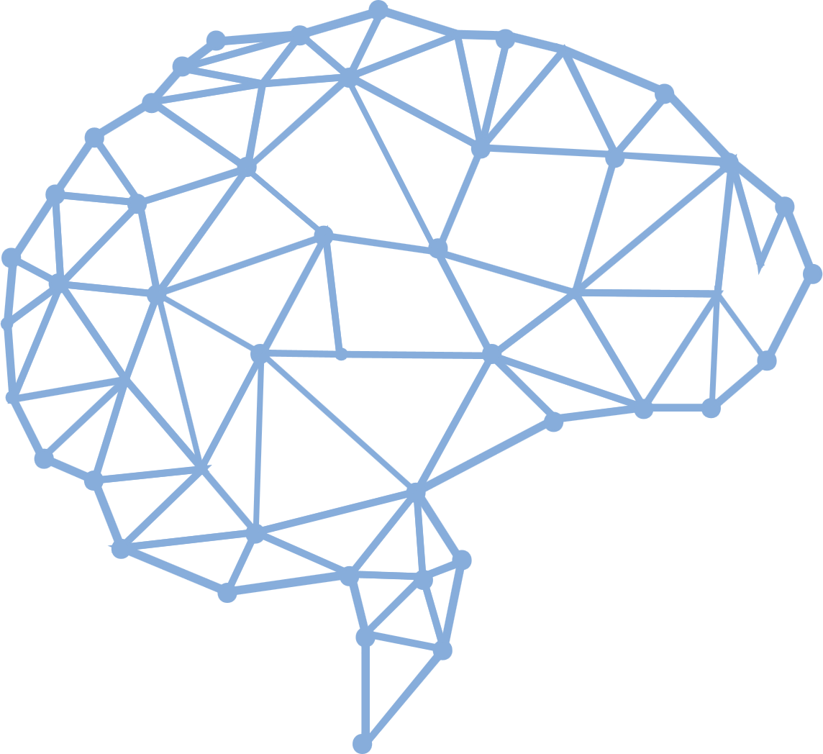
Deep Learning Models
Long Short-Term Memory (LSTM)
Is an artificial recurrent neural network (RNN) architecture used in deep learning. And is RNN capable of learning order dependence in sequence prediction problems as a behavior required in complex problem domains like machine translation, speech recognition, and more.
Result | Hyper- Parameters
40 | Epochs
88% | Accuracy
Categorical_Crossentropy | Loss
Soft-max | Activation
Adam | Optimizer

Slide 13

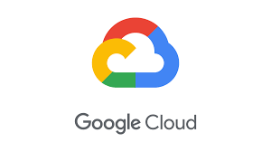


Tools
Twilio is a modern communication API Used by developers for establishing communications.
Google Cloud Platform is a part of Google Cloud, which is a public cloud infrastructure and application programming interfaces (APIs) for machine learning and enterprise mapping services.

Slide 14


Road Map for AI Call
Receive Call
Pre-processing
Classification
Text to Speech
01
02
03
04
05
06
07
08
Speech to Text
Target Word
Make Decision
End Call

Slide 15
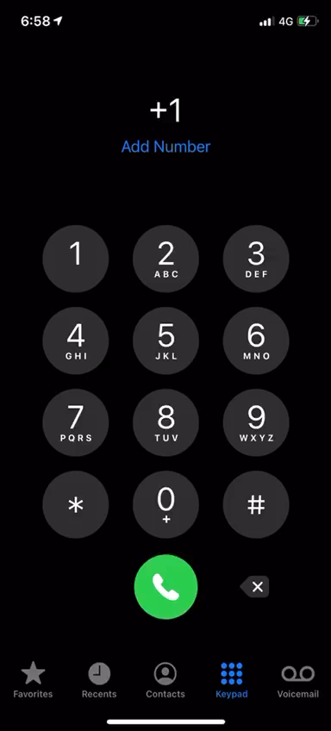
Live Calltbot Demonstration

Slide 16
Conclusion
Callbot will eliminate waiting times and improve customer satisfaction.
The best model is LSTM Because it deal with speech recognition.
In the deployment phase we use Twillio and Google Cloud.
The future work make more classes to deal with more of requests.

Slide 17
Thank You
No dream is impossible when Allah is with you.

